Slide 1
Exploring the data

Slide 2
DeltaFrequency Band

Slide 3
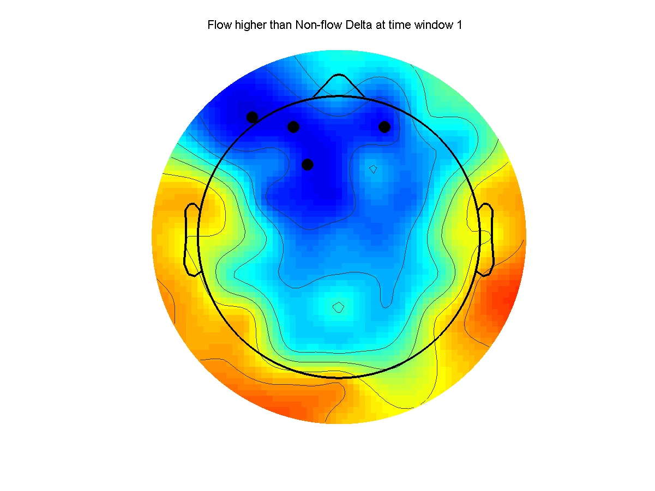
Flow higher than Non-flow Delta at time window 1

Slide 4
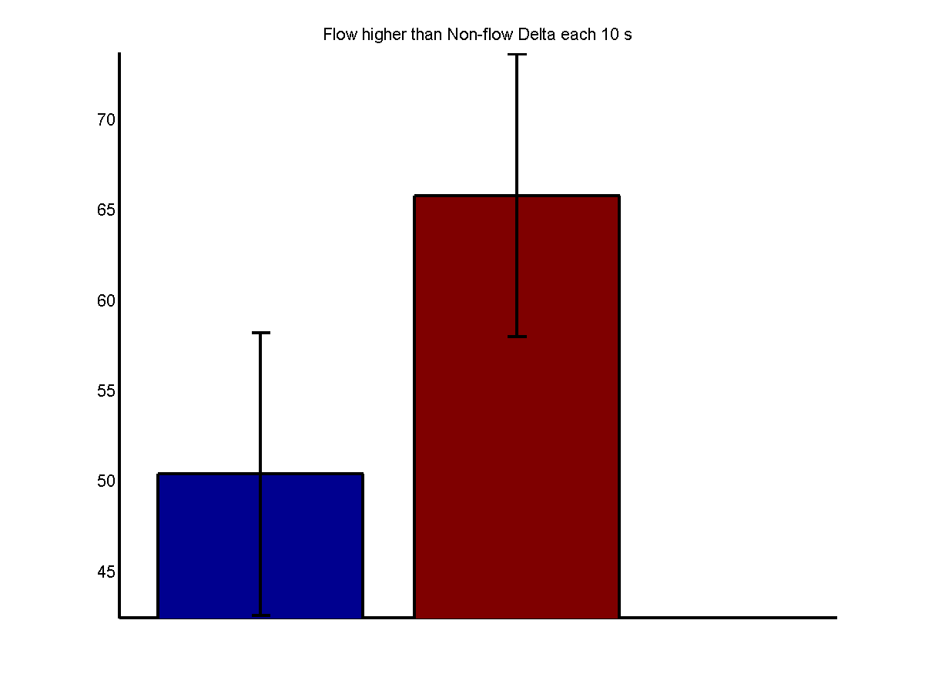
Flow higher than Non-flow Delta each 10 s

Slide 5
ThetaFrequency Band

Slide 6
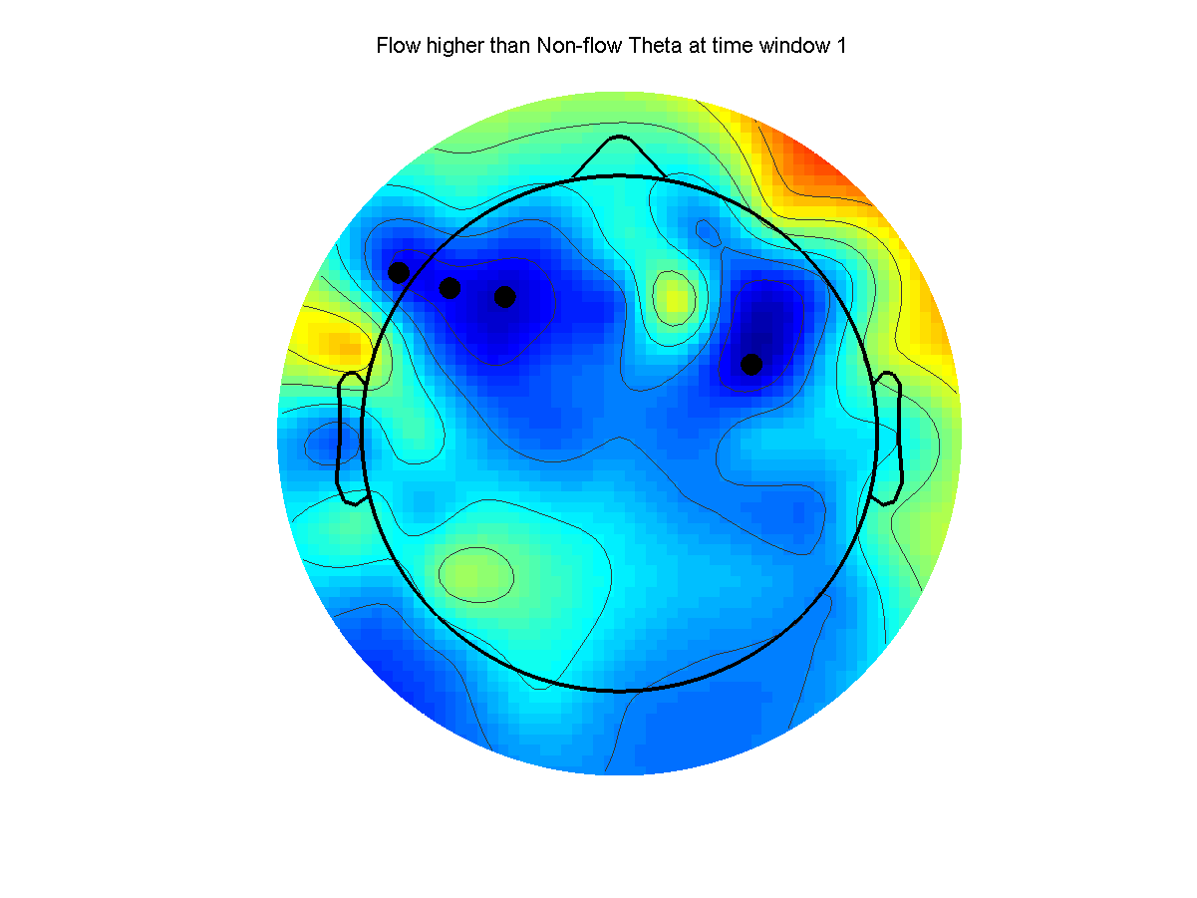
Flow higher than Non-flow Theta at time window 1

Slide 7
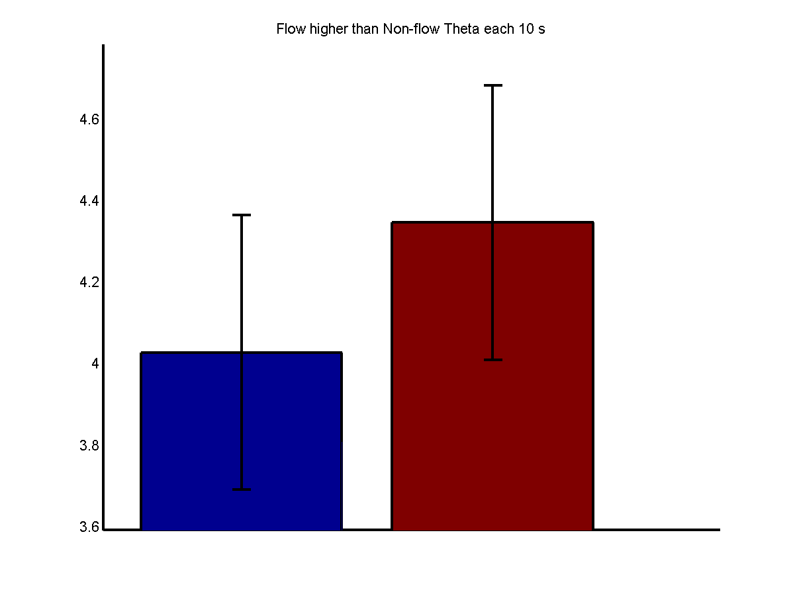
Flow higher than Non-flow Theta each 10 s

Slide 8
Alpha 1Frequency Band

Slide 9
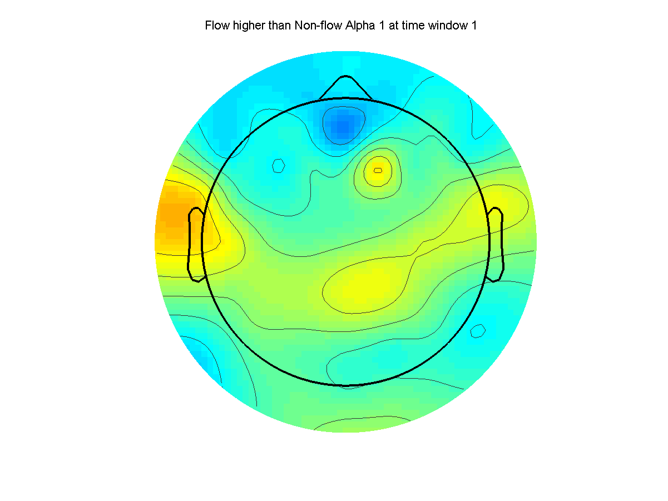
Flow higher than Non-flow Alpha 1 at time window 1

Slide 10
Alpha 2Frequency Band

Slide 11
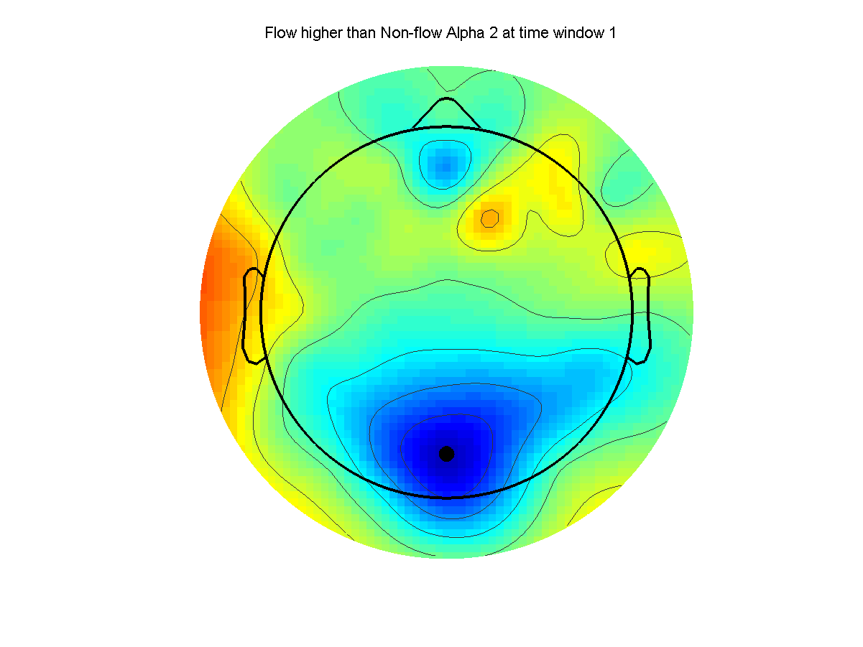
Flow higher than Non-flow Alpha 2 at time window 1

Slide 12
BetaFrequency Band

Slide 13
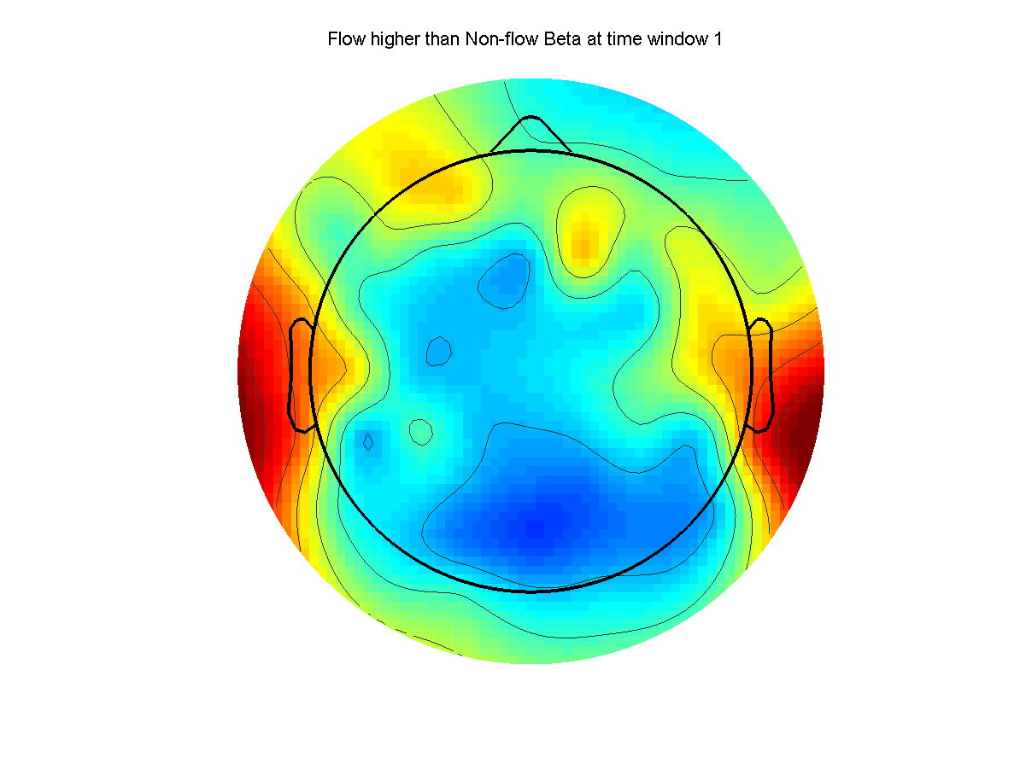
Flow higher than Non-flow Beta at time window 1

Slide 14
Gamma 1Frequency Band

Slide 15
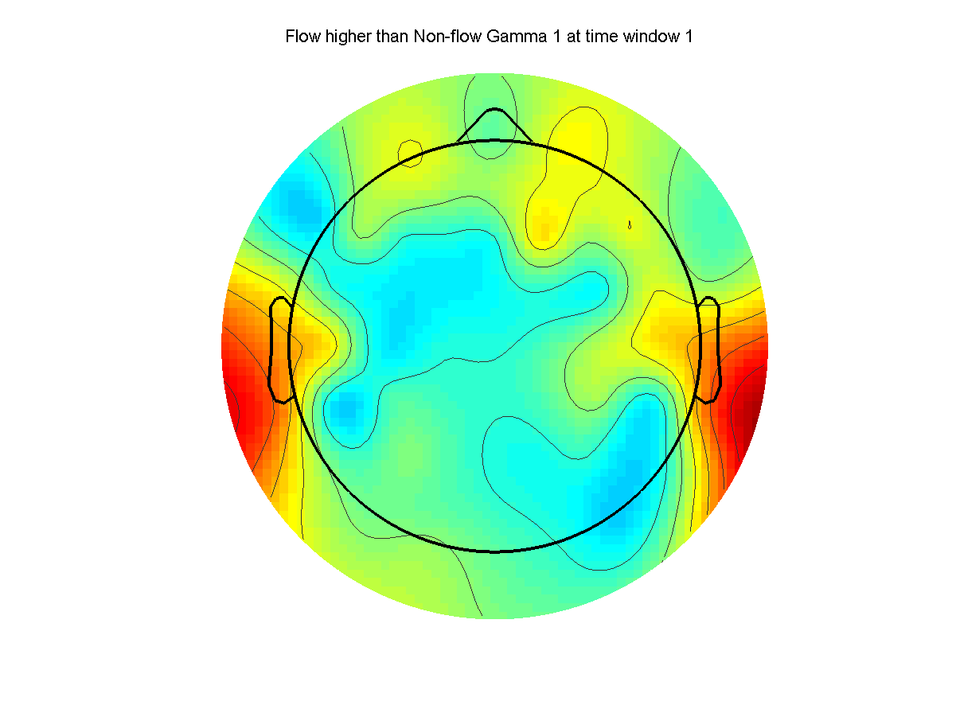
Flow higher than Non-flow Gamma 1 at time window 1

Slide 16
Gamma 2Frequency Band

Slide 17
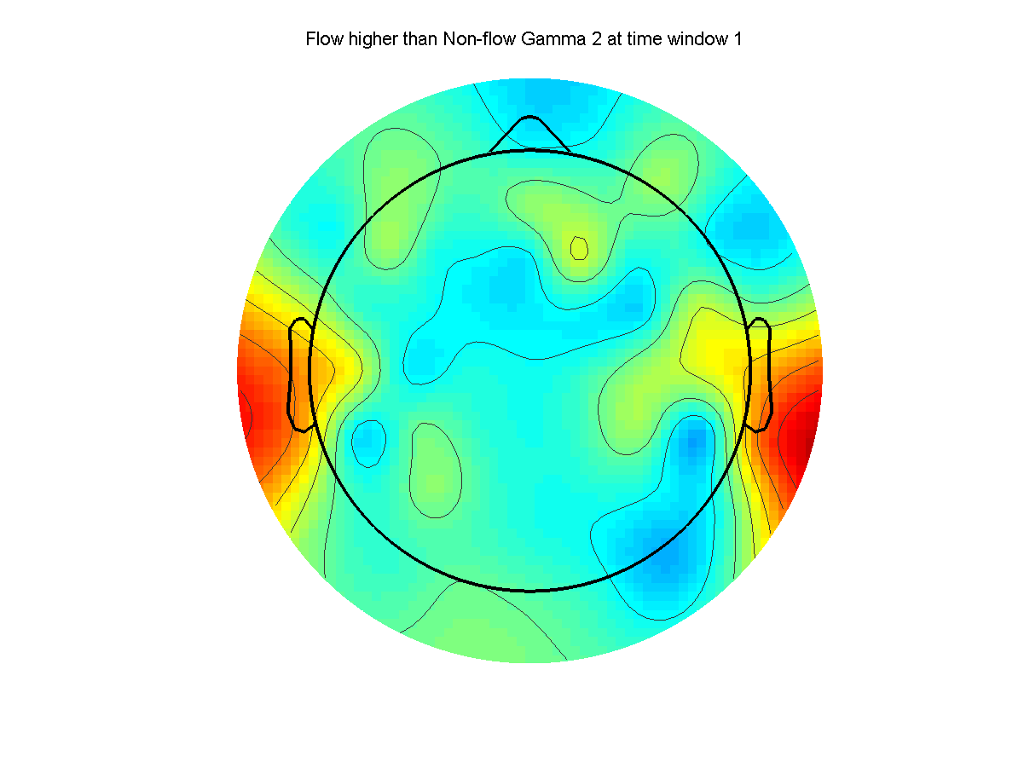
Flow higher than Non-flow Gamma 2 at time window 1

